Slide 1
Basics of IoT
Petteri Mäkelä
Seinäjoki University of Applied Sciences
https://courses.mooc.fi/org/uh-cs/courses/introduction-to-the-internet-of-things-mooc-2024--2025
Licenced under CC-BY 4.0

Slide 2
Basics of IoT
Material
https://github.com/SeAMKedu/measurements_iot
Helsinki University Course
https://courses.mooc.fi/org/uh-cs/courses/introduction-to-the-internet-of-things-mooc-2024--2025

Slide 3
Target of the lessons
The aim of today’s lessons is to create a simple web application that displays measurement data collected from a device
The web application consists of the following parts:
Server-side program (backend), which receives the measurements and sends them to a web page.
HTML page made with Google charts, which shows the measurement data in graphical form
A Python program, which simulates the device making the measurements (for example Raspberry Pi)
The server-side program will be implemented with Python Flask. Other alternatives could be Node.js, Java Spring Boot, ASP.Net, etc.

Slide 4
Internet of Things
Devices that connect to the Internet or to other devices are everywhere. Most people have a smartphone, and people increasingly have tablets, smartwatches, or wearable devices.
Homes and offices are populated by connected appliances ranging from TVs to washing machines.
Internet connected devices are also used smart cities, healthcare and manufacturing industry.
These devices form a broad computing ecosystem which is known as the Internet of Things or IoT.
https://courses.mooc.fi/org/uh-cs/courses/introduction-to-the-internet-of-things-mooc-2024--2025/chapter-1/1
Licenced under CC-BY 4.0

Slide 5
Internet of Things
The Internet of Things is built around connected devices which refer to any computing equipment that is connected to the Internet or that can connect with other devices in their vicinity.
Currently there are 17 billion devices already connecting to the Internet, from which more than half are other than PC’s, tablets or phones.
The Internet of Things is not only the dominant source of computing devices but is also one of the fastest-growing ICT sectors.
https://courses.mooc.fi/org/uh-cs/courses/introduction-to-the-internet-of-things-mooc-2024--2025/chapter-1/1
Licenced under CC-BY 4.0

Slide 6
The Internet of Things: Definition
The Internet of Things is a paradigm where physical and virtual things are interconnected through communication technologies with the goal of providing a global platform for advanced services of the information society.
ITU-T Y.2060 recommendation of the Internet of Things standards initiative http://www.itu.int/en/ITU-T/gsi/iot/
Objects that are addressable and identifiable are things. Things that are interconnected are part of the Internet of Things, provided they can be used to develop applications / services.
https://courses.mooc.fi/org/uh-cs/courses/introduction-to-the-internet-of-things-mooc-2024--2025/chapter-1/1
Licenced under CC-BY 4.0

Slide 7
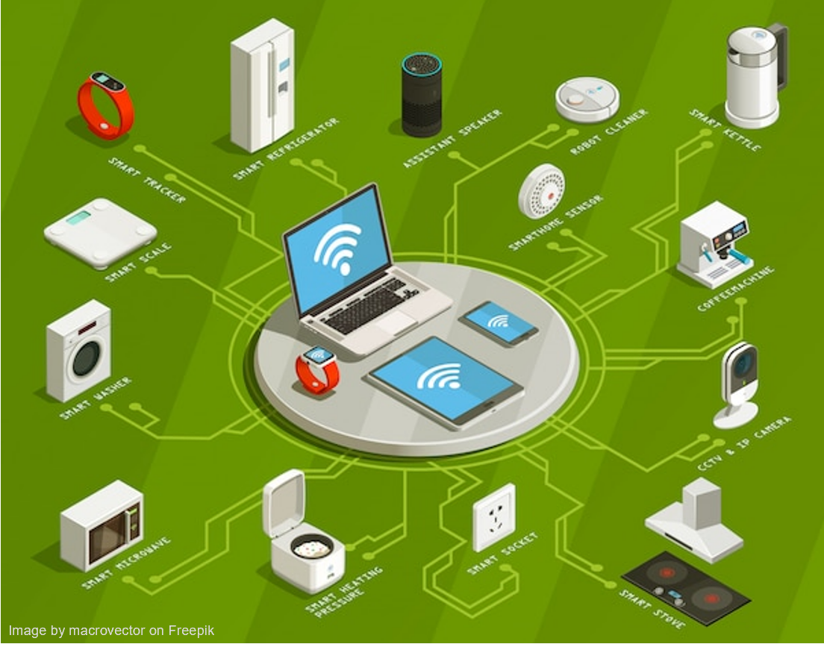
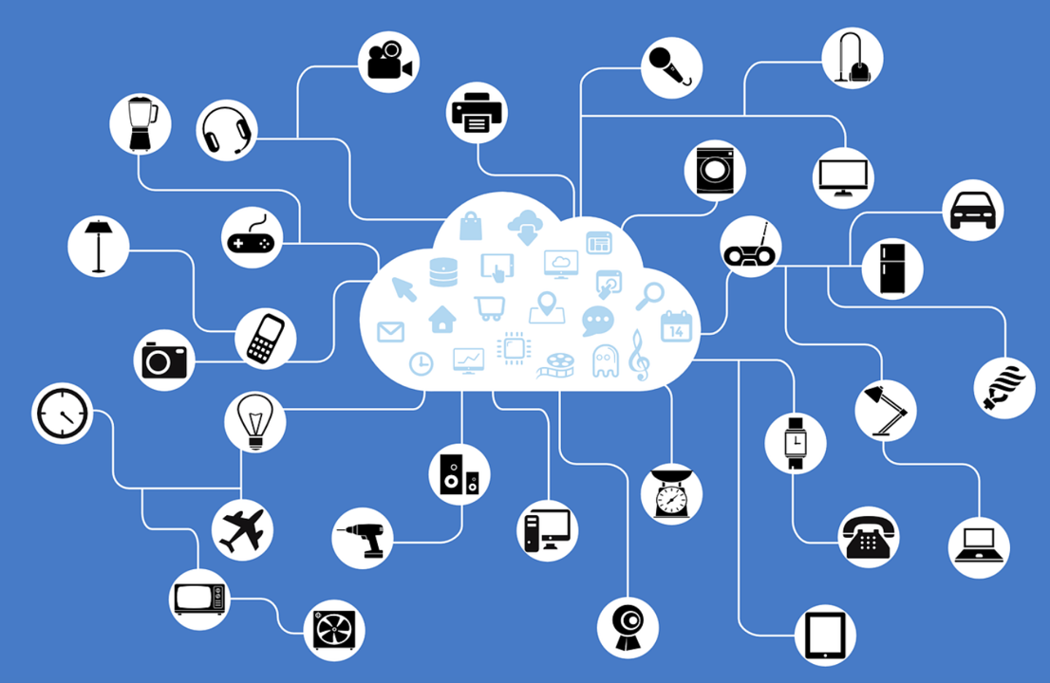
Things
https://courses.mooc.fi/org/uh-cs/courses/introduction-to-the-internet-of-things-mooc-2024--2025/chapter-1/1
Licenced under CC-BY 4.0

Slide 8
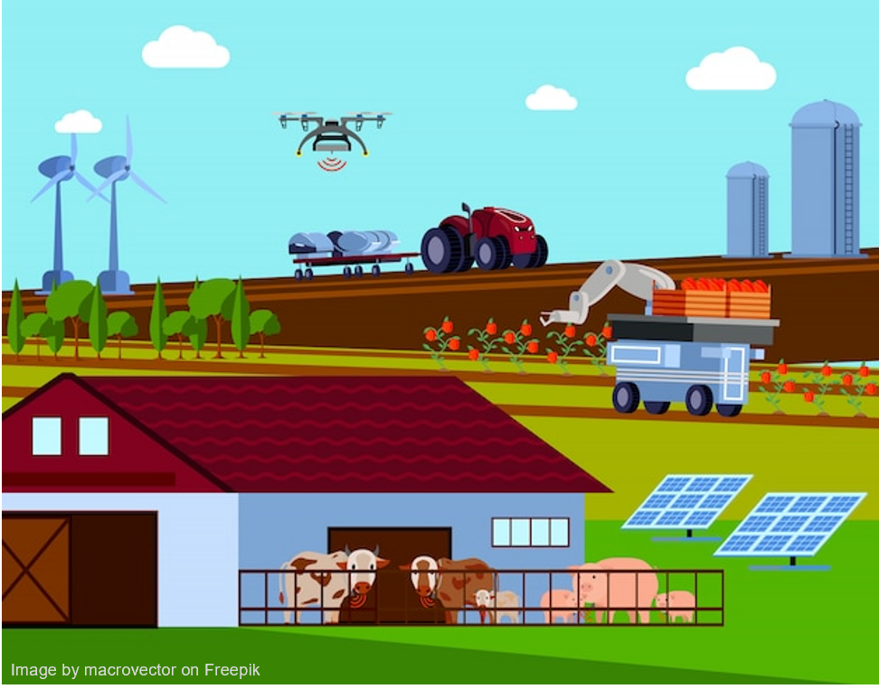
Applications - Agriculture
monitoring soil conditions
automate irrigation schedules
smart collars and implantable sensor devices are used to monitor animal welfare, activity, location, and behavior
autonomous vehicles and drones
https://courses.mooc.fi/org/uh-cs/courses/introduction-to-the-internet-of-things-mooc-2024--2025/chapter-1/1
Licenced under CC-BY 4.0

Slide 9
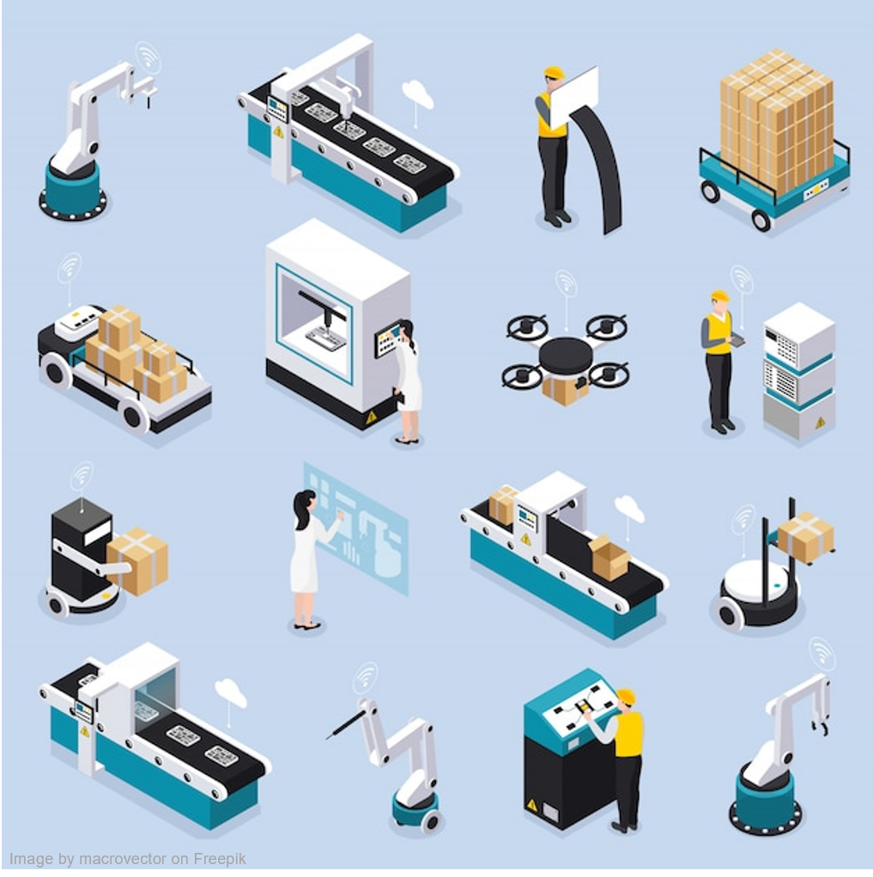
Applications – Manufacturing industry
Sensors to monitor machine performance and condition
Predictive maintenance
Analyse the productivity of the overall production chain
Digital twins
Create a virtual equivalent of a physical object or a system, and link the physical and virtual representations with each other
https://courses.mooc.fi/org/uh-cs/courses/introduction-to-the-internet-of-things-mooc-2024--2025/chapter-1/2
Licenced under CC-BY 4.0

Slide 10
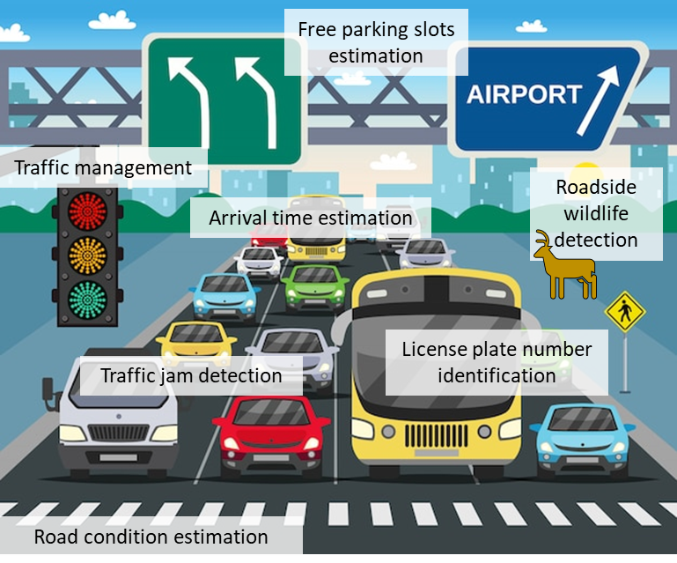
Applications – Traffic
Support finding parking spots
Automated registration plate number identification to detect entry and exit
Buses, taxis, trams, trains etc. integrate connected sensors which are used to estimate arrival time to next station
https://courses.mooc.fi/org/uh-cs/courses/introduction-to-the-internet-of-things-mooc-2024--2025/chapter-1/2
Licenced under CC-BY 4.0

Slide 11
Other applications
Energy management in buildings
motion-controlled lights to reduce excess energy use
Intelligent HVAC (heating, ventilation, and air condition)
Sensors: pressure, temperature, humidity, CO2
Smart cities
monitor and optimize the operations of the city, to identify potential problems, as well as to understand potential issues the citizen is facing.
air quality monitoring
Electrical Grid
monitor power flows and to manage production to match demand
https://courses.mooc.fi/org/uh-cs/courses/introduction-to-the-internet-of-things-mooc-2024--2025/chapter-1/2
Licenced under CC-BY 4.0

Slide 12
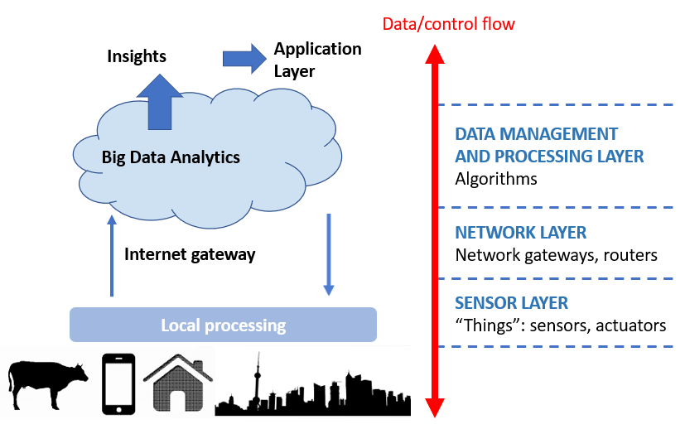
IoT Architecture - Layers
https://courses.mooc.fi/org/uh-cs/courses/introduction-to-the-internet-of-things-mooc-2024--2025/chapter-1/3
Licenced under CC-BY 4.0

Slide 13
IoT Architecture - Layers
sensing layer integrates sensors and algorithms for processing sensor data
IoT devices (often having sensors)
networking layer integrates the networking interfaces, protocols, and architectures needed for exchanging data between IoT devices
data management layer is responsible for storage, management, and processing the data for the applications
Running often in a cloud service
Data analysis, big data processing
https://courses.mooc.fi/org/uh-cs/courses/introduction-to-the-internet-of-things-mooc-2024--2025/chapter-1/3
Licenced under CC-BY 4.0

Slide 14
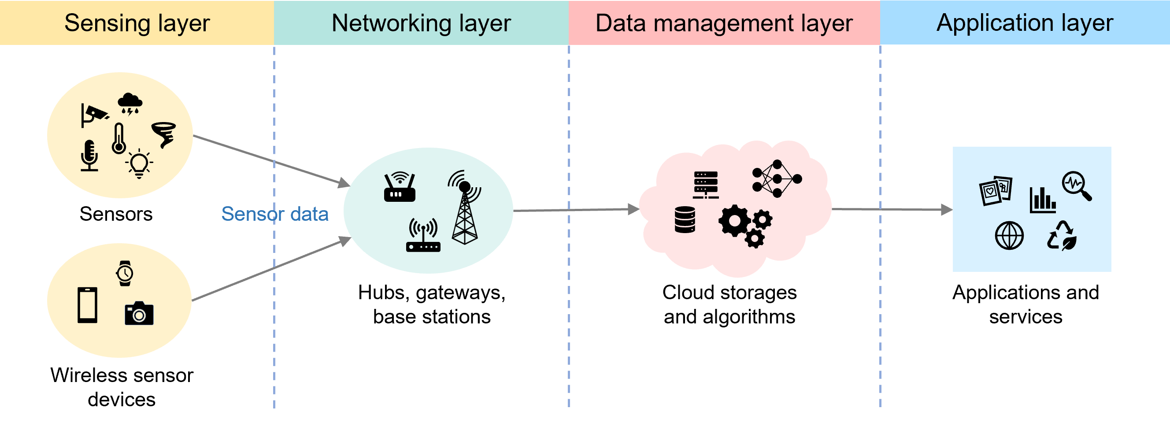
End-to-end IoT Architecture
https://courses.mooc.fi/org/uh-cs/courses/introduction-to-the-internet-of-things-mooc-2024--2025/chapter-1/3
Licenced under CC-BY 4.0

Slide 15
End-to-end IoT Architecture
Sensor enabled IoT devices connect to a hub or gateway which then transfers the information to a server or a cloud that processes the sensor measurements.
Users interact with the IoT devices and the information they gather through applications and services that are implemented on top of the cloud service.
https://courses.mooc.fi/org/uh-cs/courses/introduction-to-the-internet-of-things-mooc-2024--2025/chapter-1/3
Licenced under CC-BY 4.0

Slide 16
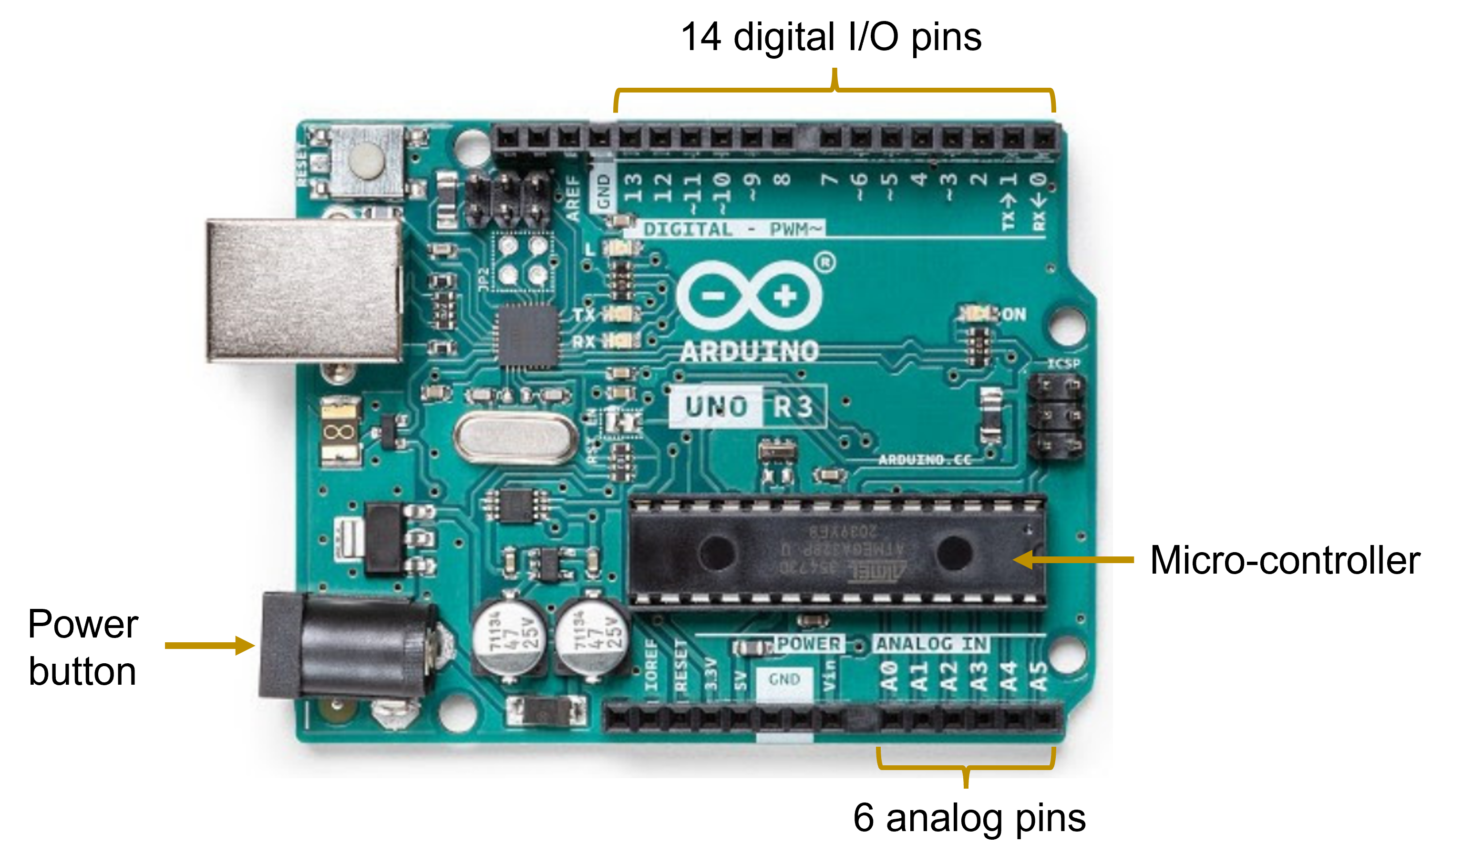
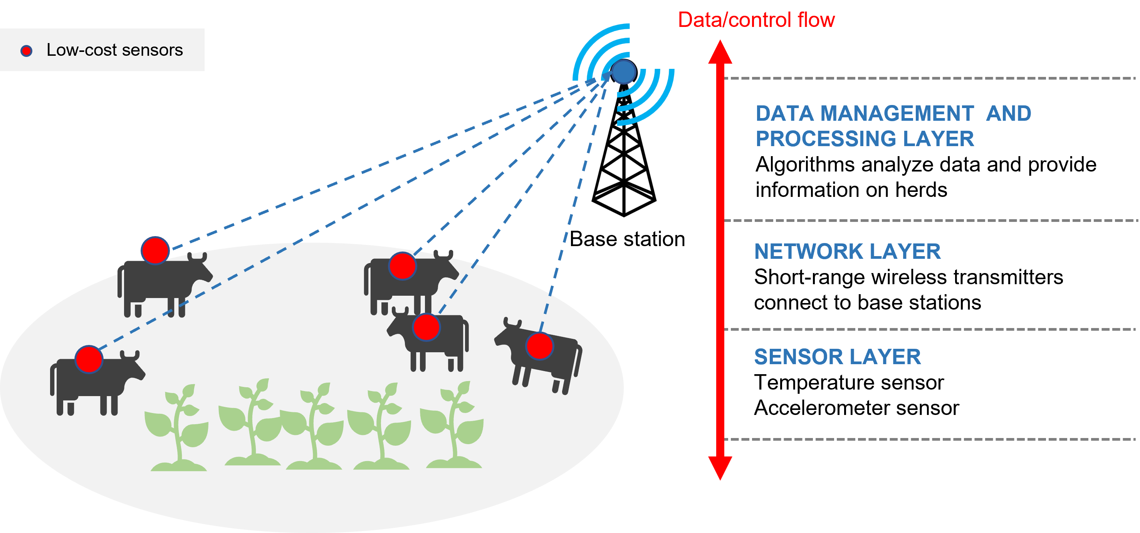
Smart devices
The smart device can sense, store, interpret data, and intercommunicate with other smart devices and systems
Sensors
CPU
Networking (e.g. NB-IoT)
https://courses.mooc.fi/org/uh-cs/courses/introduction-to-the-internet-of-things-mooc-2024--2025/chapter-1/3
Licenced under CC-BY 4.0

Slide 17
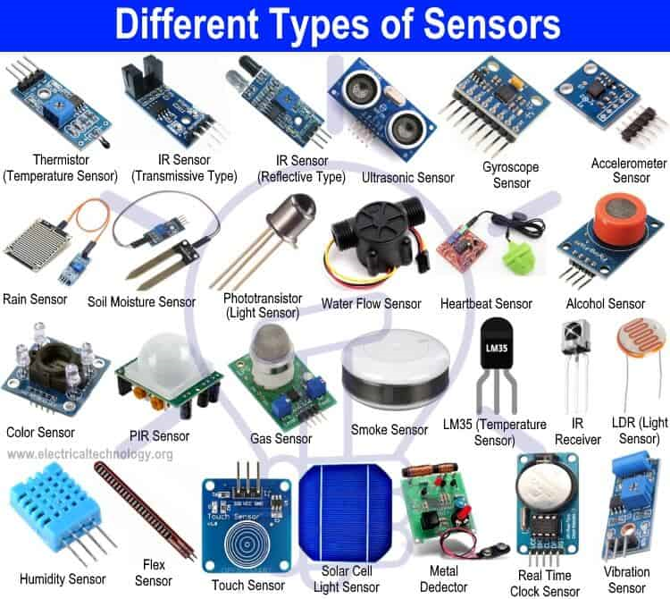
Sensors
Barometer for detecting atmospheric pressure (used, e.g., to detect weather or when the person is moving up/down).
Accelerometer, gyroscope, and a magnetometer for measuring user and device motion and orientation.
Temperature and humidity sensors
Proximity sensors (infrared sensors used to detect when someone is nearby).
GPS (GNSS) for location tracking.
https://courses.mooc.fi/org/uh-cs/courses/introduction-to-the-internet-of-things-mooc-2024--2025/chapter-3/1
Licenced under CC-BY 4.0

Slide 18
Networking technologies
Short range
ZigBee
Bluetooth and Bluetooth Low Energy (BLE)
WLAN
Long range
LoRa, low power consumption, small amount of data, 250 bps - 50 kbps
SigFox, ultra-narrow band technology, 100 bps
Cellular IoT
LTE-M, < 4 MBps
NB-IoT, 66 kbps
https://courses.mooc.fi/org/uh-cs/courses/introduction-to-the-internet-of-things-mooc-2024--2025/chapter-4
Licenced under CC-BY 4.0

Slide 19
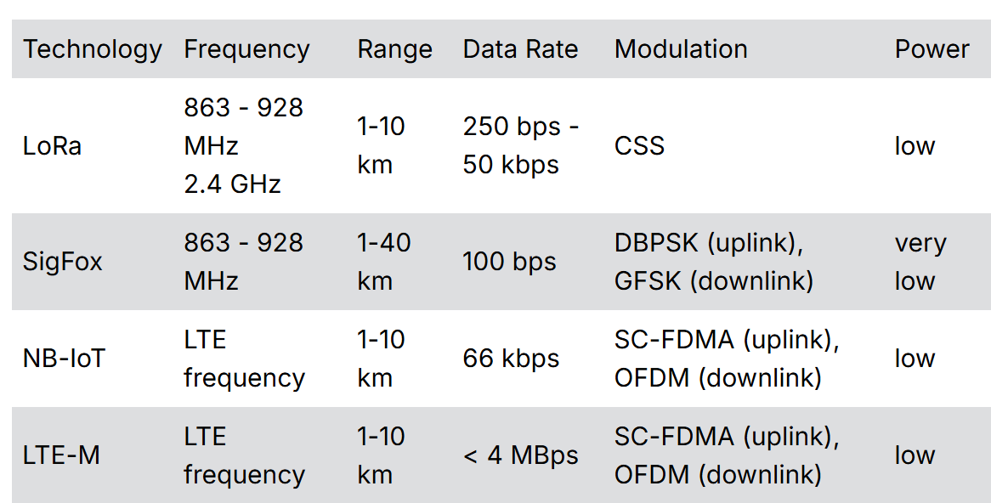
Networking technologies (long range)
https://courses.mooc.fi/org/uh-cs/courses/introduction-to-the-internet-of-things-mooc-2024--2025/chapter-4
Licenced under CC-BY 4.0

Slide 20
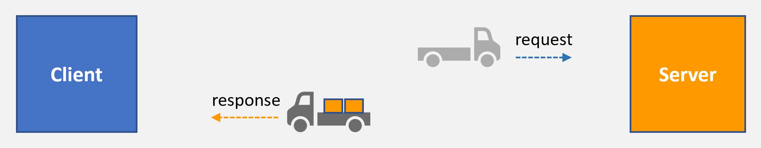
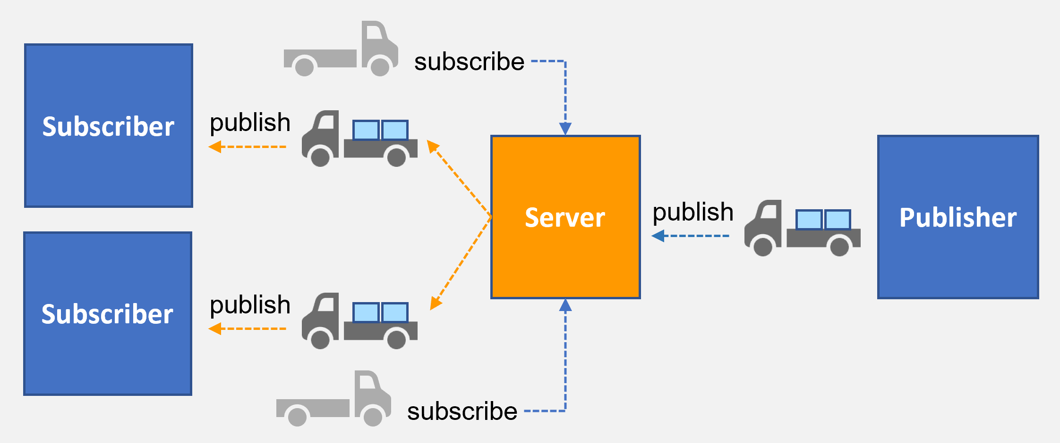
Networking -protocols
HTTP, CoAP
MQTT, AMQP
https://courses.mooc.fi/org/uh-cs/courses/introduction-to-the-internet-of-things-mooc-2024--2025/chapter-4/5
Licenced under CC-BY 4.0

Slide 21
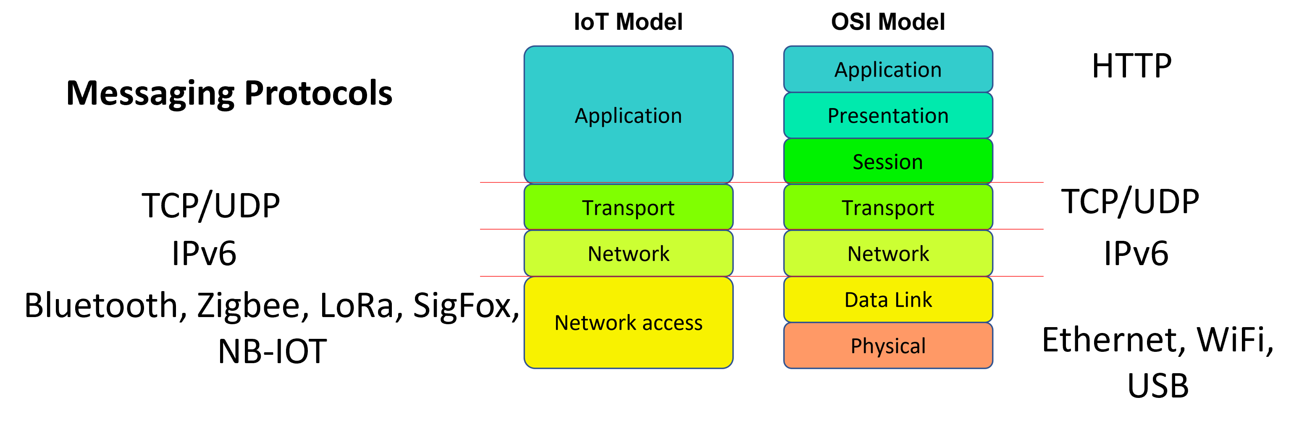
Networking
https://courses.mooc.fi/org/uh-cs/courses/introduction-to-the-internet-of-things-mooc-2024--2025/chapter-4/5
Licenced under CC-BY 4.0

Slide 22
Data Management Layer
Devices
Collection
Message
Broker
Trans- formation,
Storage
Presentationand action
Siemens PLC
Dashboards
Beckhoff PLC
Kafka
Event Hubs
IoT Hub
Real-time
Analytics
Field
Gateways
(OPC UA to MQTT/ AMQP)
Business intelligence
Wireless Sensor Networks
Database
Devices or services to
take action
Raspberry PI
IP Capable Devices
Batch
Analytics

Slide 23
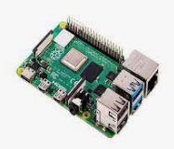
The IoT system
MQTT
Thingspeak InfluxDB
HTTP
HTTP POST
Server
(Python Flask)
HTTP GET
Client (browser)
Simulator

Slide 24
Thingspeak Exercise

Slide 25
Thingspeak Exercise
Let’s make an exercise where we transfer data from a simulated device to the Thingspeak cloud service.
The purpose is to learn how a simple IoT application works
We will utilize Thingspeak cloud service for showing IoT data in real-time.
We will learn basics of
HTTP protocol
JSON format

Slide 26
Thingspeak Exercise
We could use a IoT device, such as Raspberry Pi, but this time we only simulate the device by a simple Python program.
The Python program generates the measurement data. The data is sent to Thingspeak service by HTTP POST every 16 seconds (free version of Thingspeak has this restriction)
There are following phases at the exercise:
Configure the Thingspeak service
Testing the data transmission with HTTP Post with Postman or Visual Studio Code REST Client.
Making Python program for data simulation
Running the simulator program and examining the Thingspeak
You need to install the following programs to your computer
Python (3)
Visual Studio Code
Visual Studio Rest Client (or Postman)

Slide 27
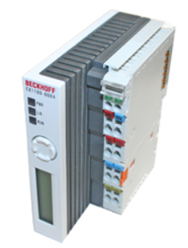
Example Application
In a real application, you may have a program, which collects data from a device and forwards that data to the IoT server application (Thingspeak in this case)
Another possibility is that the program responsible for communication runs in an embedded device (such as Raspberry Pi) and sends the measurements directly to the IoT server application.
In our exercise, we just have a Python program which generates measurement data and sends it to the IoT service.
Collecting data from the device
HTTP, MQTT
ThingsPeak
Python
Internet connected
device

Slide 28
HTTP
HTTP (HyperText Transfer Protocol) is the foundation of data communication on the web. It operates as a request-response protocol between a client (like a web browser) and a server.
Common request methods include GET (retrieve data), POST (submit data), PUT (update data), and DELETE (remove data).
Uniform Resource Locators (URLs) specify the address of a resource on the web.
Headers: These provide metadata about the request or response, such as content type and status codes.
Status Codes: Indicate the result of the request (e.g., 200 OK, 404 Not Found).
Sessions: HTTP is stateless, meaning each request is independent, but sessions can be managed using cookies.
HTTP is commonly used with web applications and IoT communications.

Slide 29
REST
REST (Representational State Transfer) is an architectural style for designing networked applications.
REST relies on stateless communication, where each request contains all necessary information.
REST uses standard HTTP methods to interact with resources identified by URIs. Resources are typically represented in formats like JSON or XML.
The architecture promotes a client-server model, allowing for scalability and separation of concerns. This simplicity and flexibility make REST a popular choice for web services and APIs.
Thingspeak service has a REST API, which is used for data transfer.

Slide 30
JSON
[
{
"time": 1,
"pressure": 1001.0,
"temperature": 34.0
},
{
"time": 2,
"pressure": 1000.0,
"temperature": 33.0
},
{
"time": 3,
"pressure": 1002.0,
"temperature": 44.0
}
]
JSON (JavaScript Object Notation) is a simple open standard file format used for data interchange.
Below is an example of a table in JSON format that contains measurement records.

Slide 31
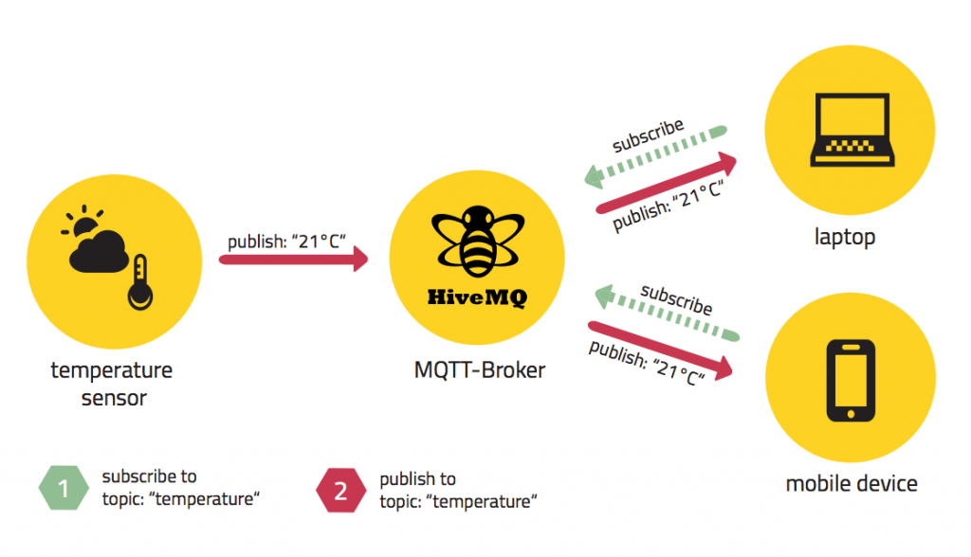
MQTT
Instead of HTTP we could communicate with Thingspeak also by using MQTT protocol.
MQTT is based on the publisher-subscriber model.
Data producers (things) are publishers. There can be multiple subscribers, and they can subscribe to data from many publishers.
MQTT does not include message queues, so the data reader must always be listening for the subscribed data.
Data producers and consumers are not aware of each other.
However, we don’t use MQTT this time.

Slide 32
Thingspeak
Create an account for yourself on Thingspeak by following the instructions on the following pages
https://thingspeak.com/

Slide 33
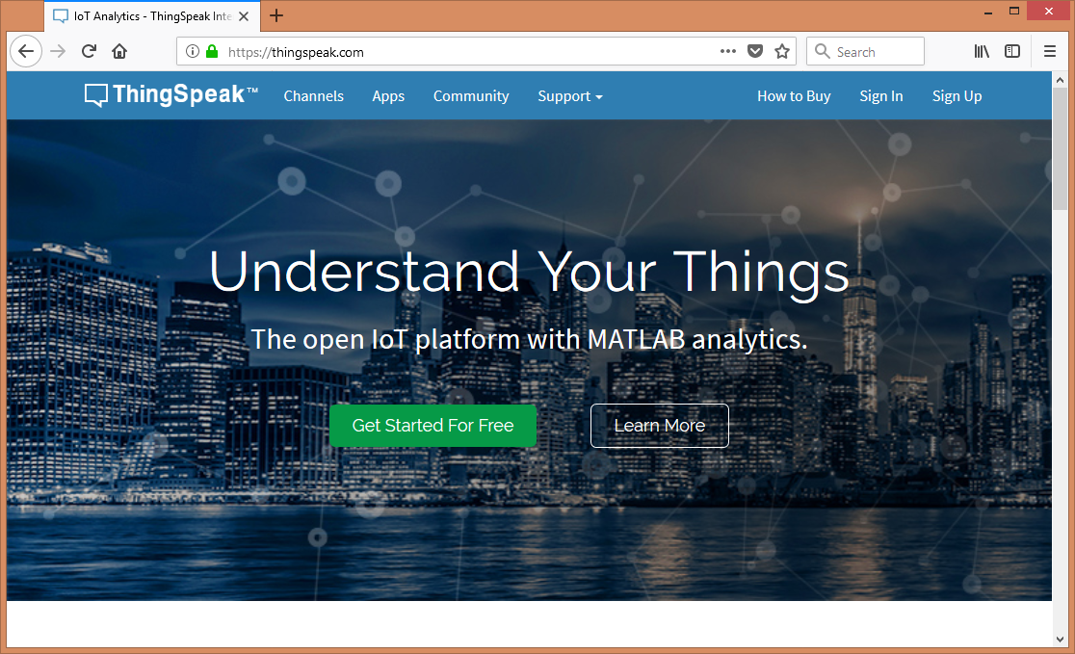
Niko Ristimäki

Slide 34
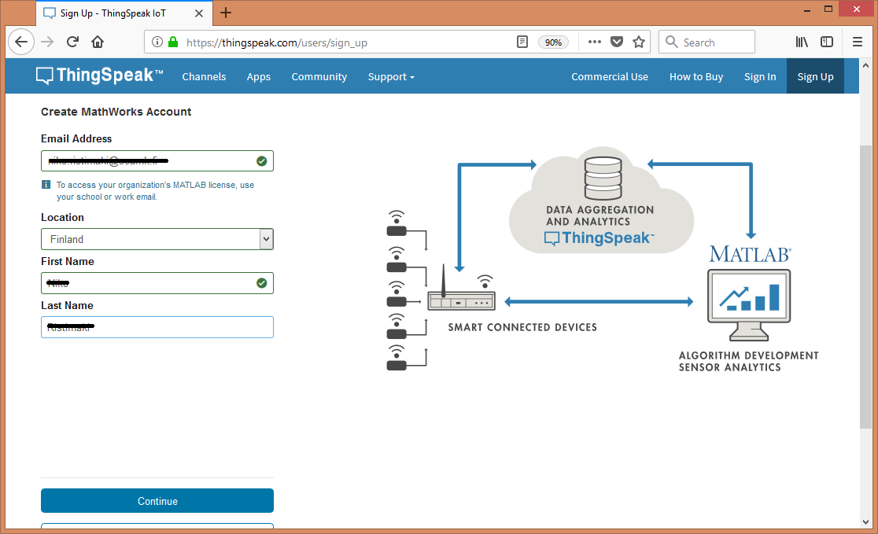
Niko Ristimäki

Slide 35
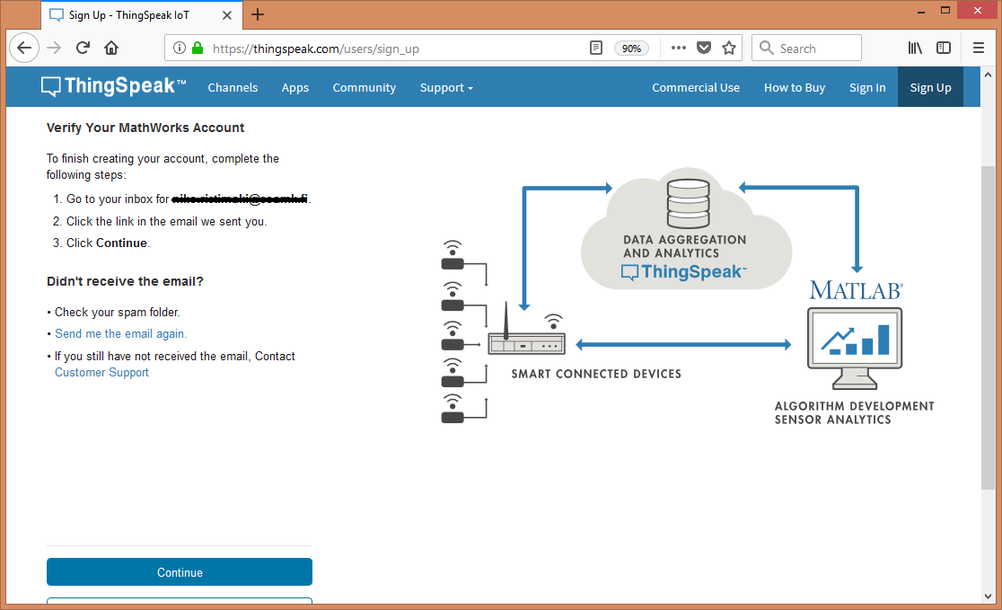
Niko Ristimäki

Slide 36
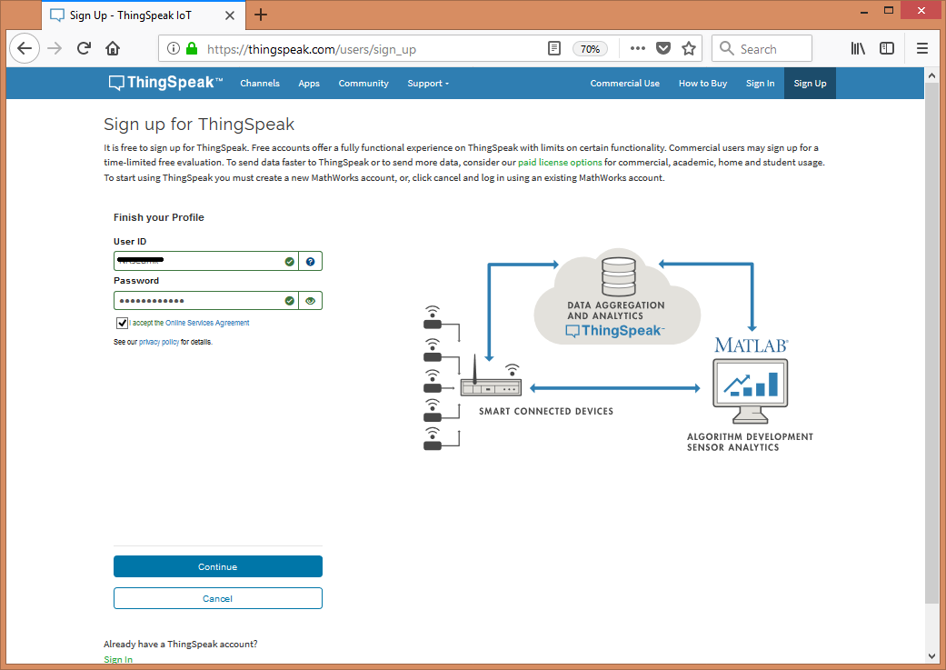
Niko Ristimäki

Slide 37
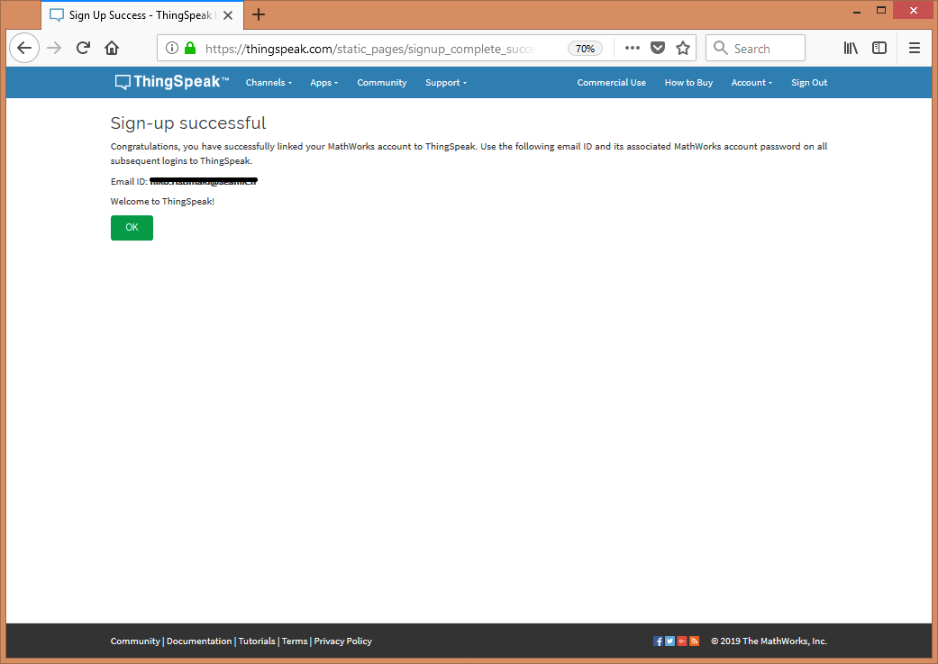
Niko Ristimäki

Slide 38
Channels
The IoT data is shown on a channel. The channel can contain many fields, such as pressure, temperature and humidity.
Create a new channel by following the instructions on the next pages.
Give a name to the channel and use field names pressure, temperature and humidity.

Slide 39
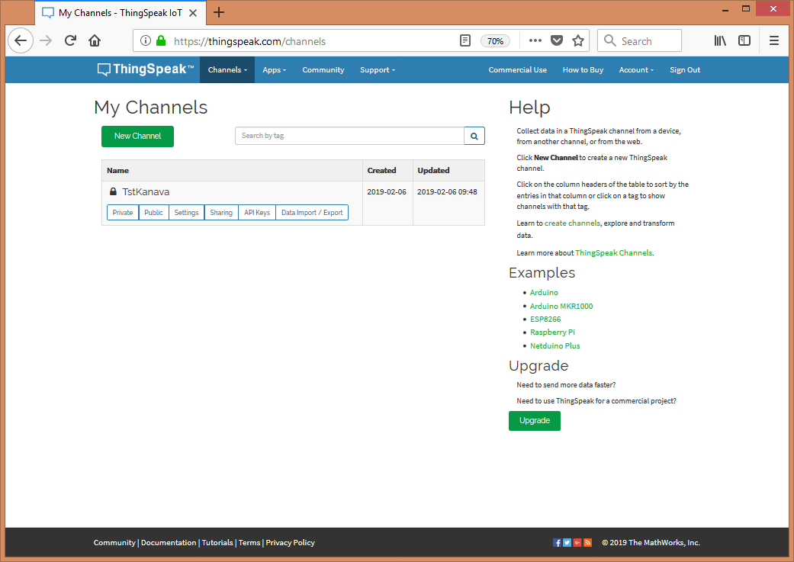
Niko Ristimäki

Slide 40
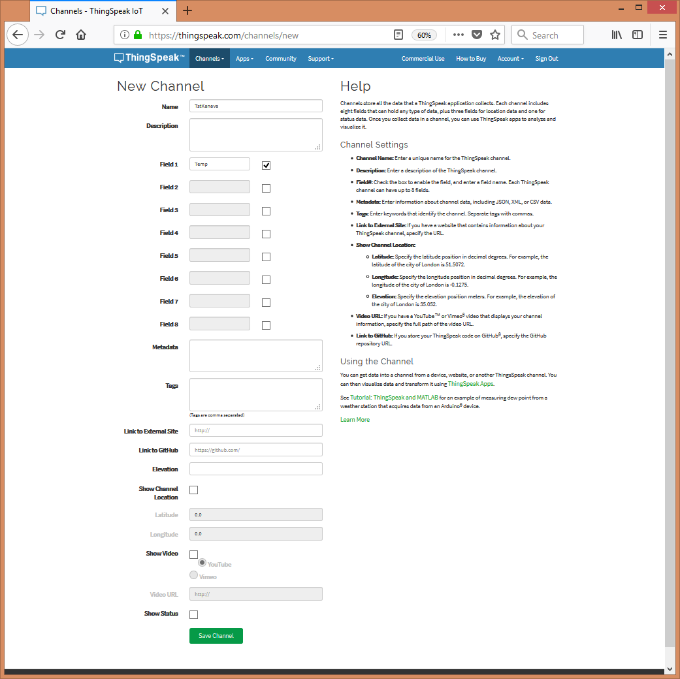
Niko Ristimäki

Slide 41
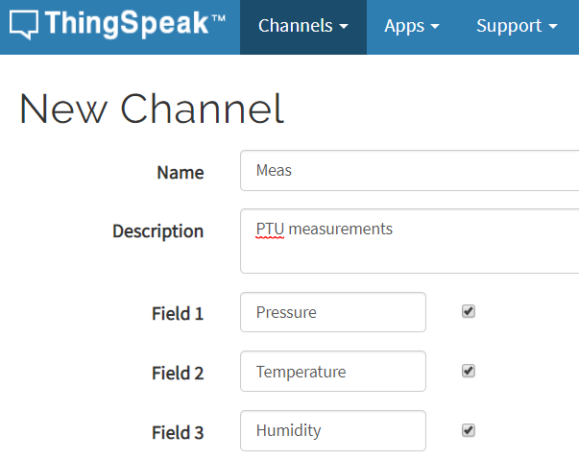
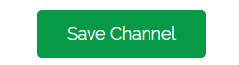
Channel information
Fill the New Channel form as shown

Slide 42
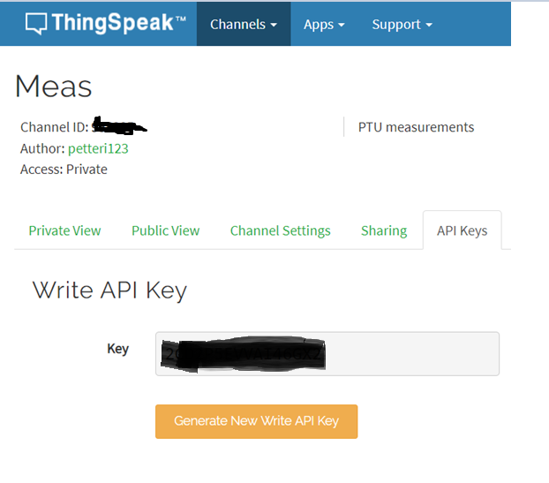
API Key
There is an API Key for each channel, what is used in the communication
Create a Write API Key

Slide 43
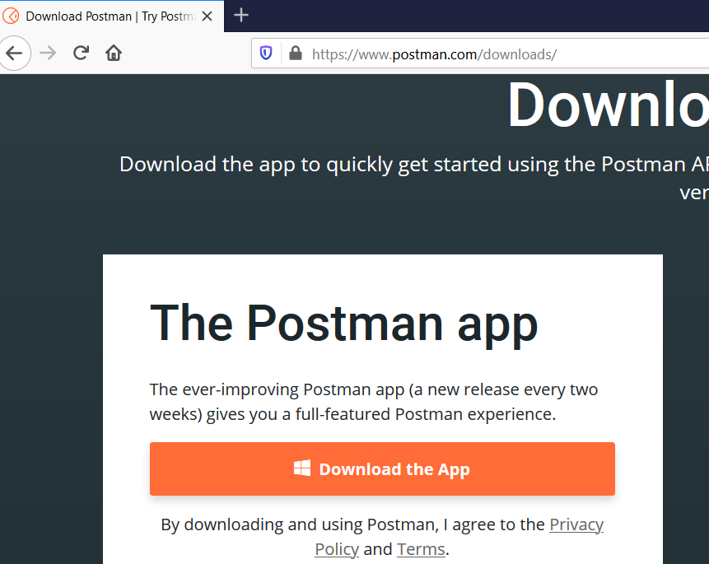
Postman
We try Thingspeak first with Visual Studio Rest Client or Postman program
Download Postman (Windows version)
https://www.postman.com/downloads/)
You don’t need to sign in to Postman. You can skip sign in and use lightweight version
Instead of Postman, you can use also Visual Studio Rest Client plugin.

Slide 44
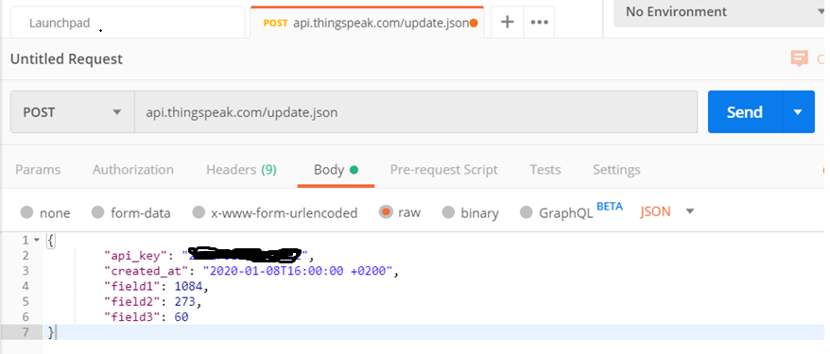
Sending data with HTTP POST
Anna tiedot Postmaniin alla olevan mallin mukaan (api_key from ThingsPeak)

Slide 45
Sending data with HTTP POST
Data to be sent is below
You have to wait 15 seconds between sending data again.
{
"api_key": "XXXXXXXXXXXXXXXXX",
"field1": 1084,
"field2": 273,
"field3": 60
}
{
"api_key": "XXXXXXXXXXXXXXXXX",
"field1": 1094,
"field2": 283,
"field3": 50
}

Slide 46
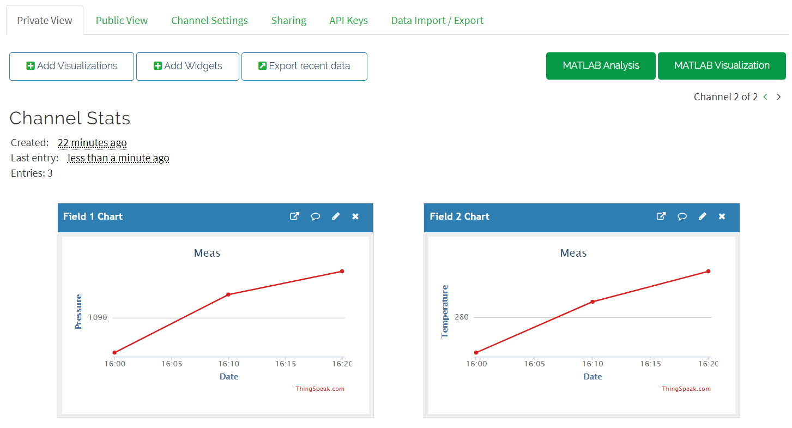
Watching Data in ThingsPeak
Choose Private View from Thingspeak to see the measurement data
See the Thingspeak documentation

Slide 47
Sending data from Python simulator program
Let’s make an application, which generates measurements and sends them to Thingspeak..
Install requests library with pip:
pip install requests
Make a program of the next page. Use your own Thingspeak API Key.
You need Visual Studio Code and Python 3.

Slide 48
Example program datagen.py
Instead of copying, write the program by yourself.
import requests # pip install requests
import math
import time
import datetime
i = 0
while i < 10:
measurement = {}
measurement["api_key"] = "XXXXX"
#measurement["created_at"] = str(datetime.datetime.now())
measurement["field1"] = 1024+5*math.sin(i/10)
measurement["field2"] = 300 + 2 * math.cos(i/3)
measurement["field3"] = 33+i%50
# serialize the data to JSON format and send it by HTTP POST
response = requests.post('https://api.thingspeak.com/update.json',json=measurement)
print(response.ok)
print(response.json())
time.sleep(16) # we must wait at least 15 seconds
i+=1

Slide 49
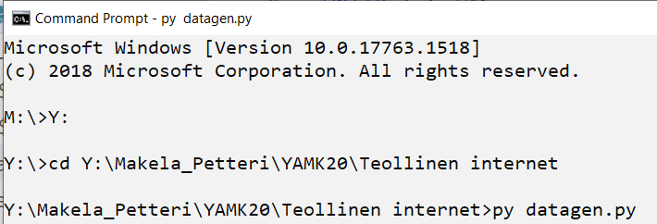
Test your program
Clear the previous data from Thingspeak
Run the Python program
py datagen.py
See the data from Thingspeak

Slide 50
Own server application
Instead of using Thingspeak, we can also build our own IoT application
Instructions to build a simple IoT application with Python Flask:
https://github.com/SeAMKedu/measurements_iot

